Slide 1
Data Analysis of Hotel Reservations Dataset

Slide 2
introduction
The file contains the different attributes of customers' reservation details.
booking status
avg_price_per_room
market_segment_type
ext.......
Data Dictionary

Slide 3
Booking_ID
no_of_adults
no_of_children
no_of_weekend_nights
no_of_week_nights
type_of_meal_plan
required_car_parking_space
room_type_reserved
lead_time
arrival_year
arrival_month
arrival_date
market_segment_type
repeated_guest
no_of_previous_cancellations
no_of_previous_bookings_not_canceled
avg_price_per_room
no_of_special_requests
booking_status

Slide 4
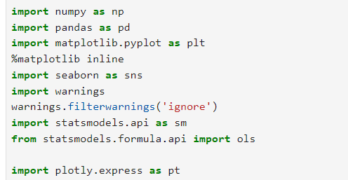
Importing Libraries

Slide 5
Read file and Data Checks to Perform
df = pd.read_csv("Hotel Reservations.csv")
DATA MANIPULATION

Slide 6
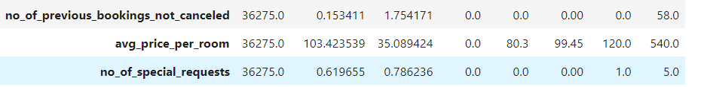
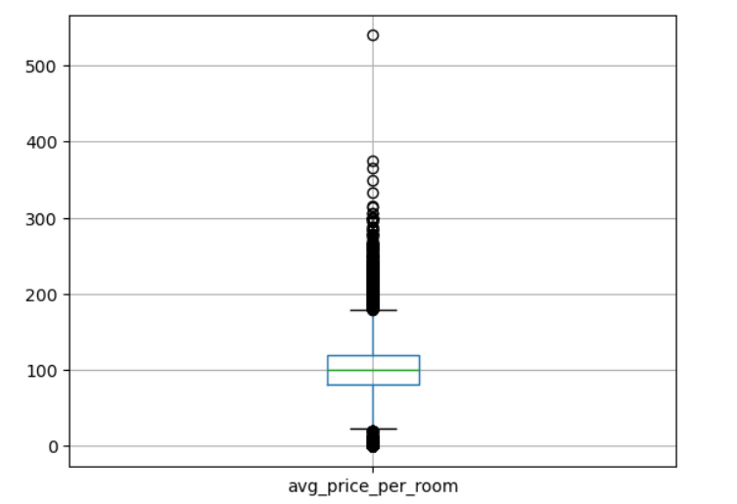
Checking outliers
The median is 99.45
The standard deviation of 103.42
The variance of 35.09
The price range 0.0 to 540.0.
The minimum value of 0.0 may indicate a potential data entry error or special cases that could skew the analysis. It might be worth investigating further.

Slide 7
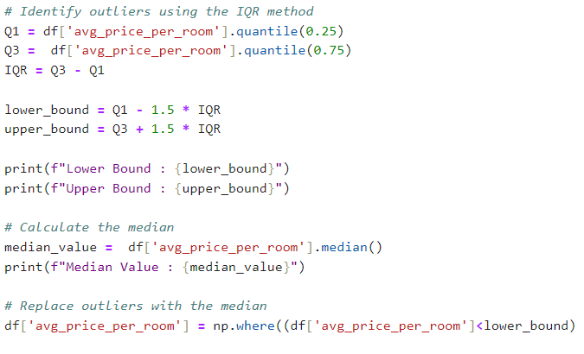
REPLACING OUTLIERS

Slide 8
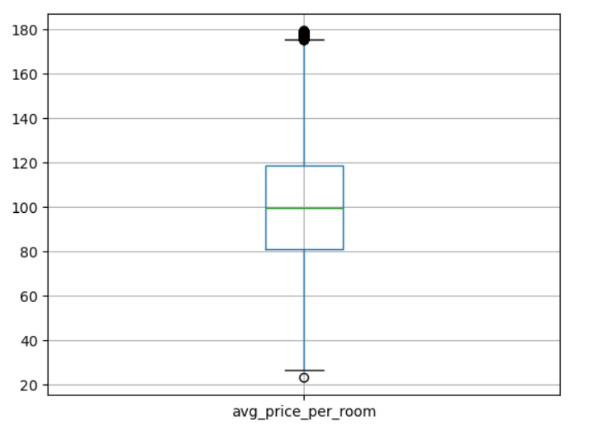
WITH MEDIAN VALUE
Ensure that replacing outliers with the median is appropriate for the analysis, as it may affect other statistical insights.
After this, visualizing the data again with a box plot to confirm that outliers have been addressed.

Slide 9
Data Analysis and Visualization

Slide 10
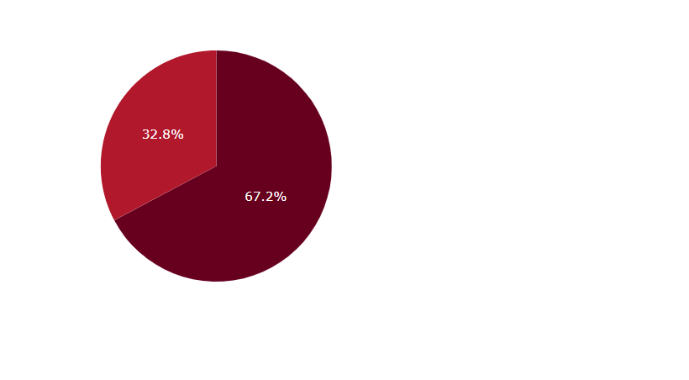

Booking status
24390 11885
BOOKING STATUS

Slide 11
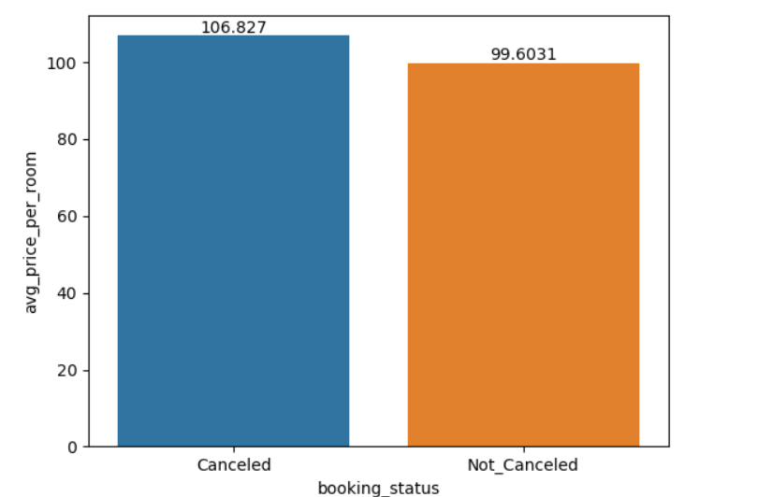
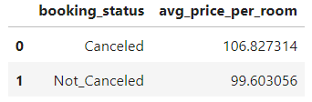
Canceled average price per room mean is higher than Not canceled average price per room mean.

Slide 12
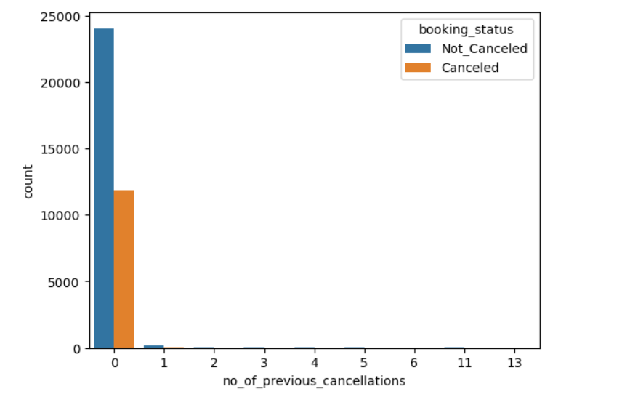
This plot helps you understand how the number of previous cancellations relates to booking statuses, providing insights into customer behavior and potential risk factors in booking patterns.

Slide 13
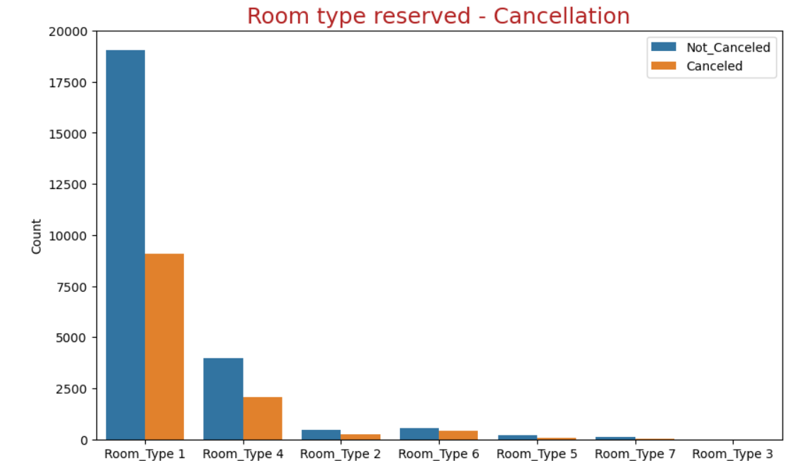
The cancelation rate is higher for the guests who reserved Room type 6 and type 2 compare to others.
Room type 1,4,2 are highly booked and canceled. this might be about room condition.
Room type 1 is booked most number of times.

Slide 14
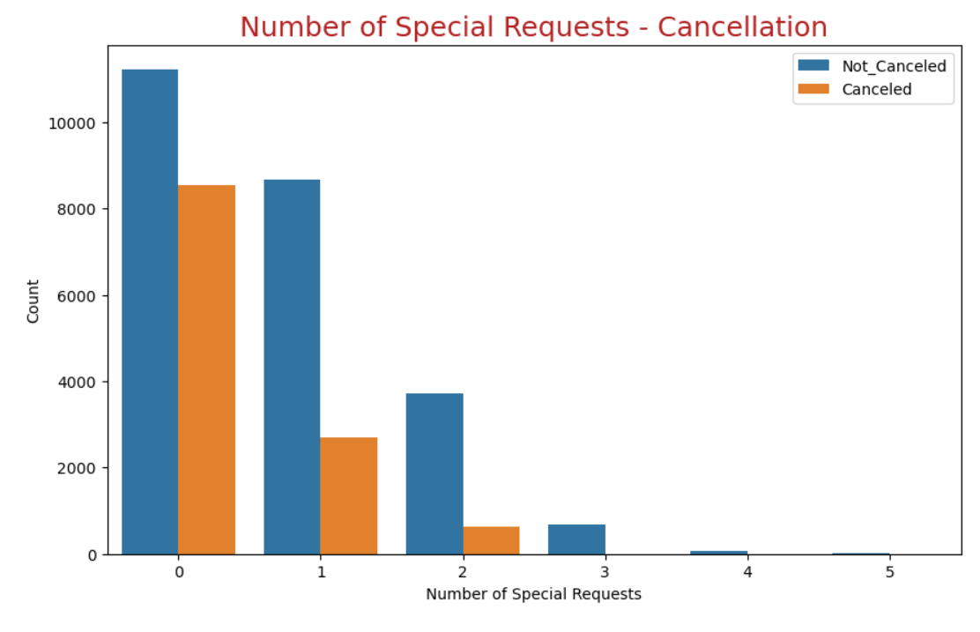
The cancelation rate is higher for the guests who don't have a special request compare to others.
If Special Request is More than 2, booking_status Will not be Canceled

Slide 15
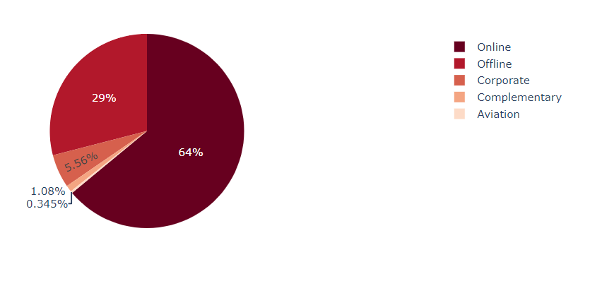
Market segmentation type
Online 23214
Offline 10528
Corporate 2017
Complementary 391
Aviation 125
Highlighting the dominance of the "Online" segment compared to the others.

Slide 16
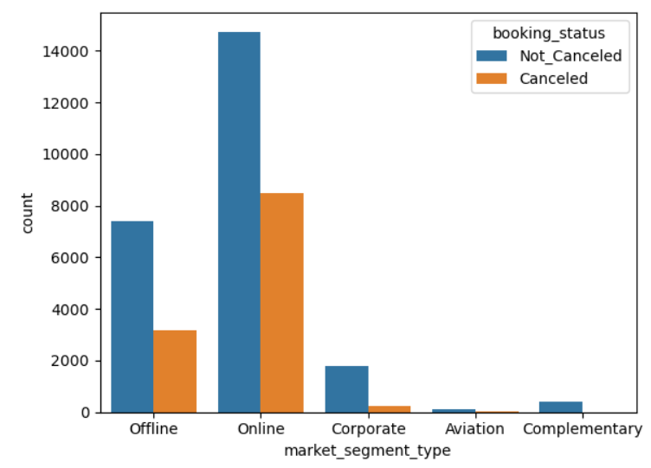
The Online market segment has the highest cancellations (8,475), suggesting potential issues with customer satisfaction or booking processes in this channel.
Stable Corporate Bookings: The Corporate segment shows a healthy ratio of cancellations (220) to active bookings (1,797), indicating reliability among corporate clients.
Offline bookings also show substantial counts, but with lower cancellations compared to Online (3,153 vs. 7,375), suggesting that customers may prefer direct engagement.
Both Canceled (37) and Not_Canceled (88) for Aviation are low, indicating limited demand or niche market characteristics.
Moderate Cancellations: The Complementary segment has a cancellation count of 391, which could reflect non-essential bookings.
booking_status market_segment_type
Canceled Aviation 37
Corporate 220
Offline 3153
Online 8475
Not_Canceled Aviation 88
Complementary 391
Corporate 1797
Offline 7375
Online 14739

Slide 17
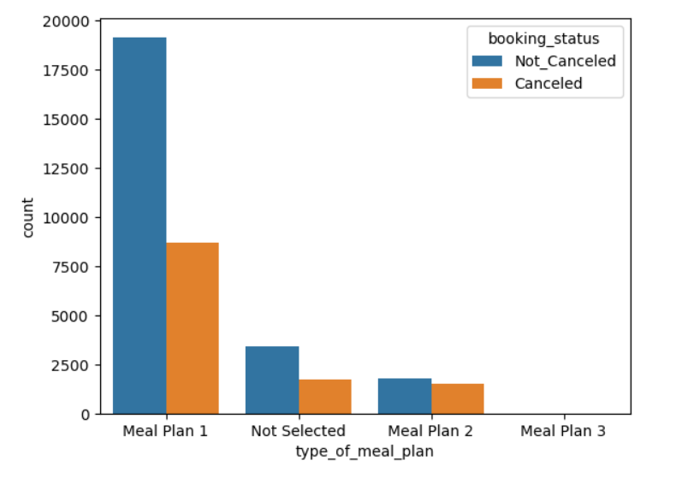
Dominance of Meal Plan 1.
Minimal Adoption: Meal Plan 3 has very low counts (only 1 canceled and 4 not canceled), suggesting it may not meet customer needs or expectations.
Cancellations Across Meal Plans: The Not Selected option shows a significant number of cancellations (1,699), which may indicate that customers who do not select a meal plan are more likely to cancel their bookings.

Slide 18
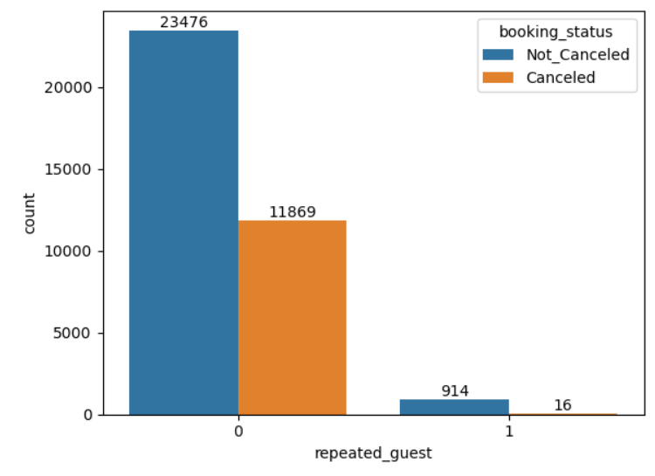
High Cancellations Among First-Time Guests:
This suggests that first-time guests may be less committed to their bookings.
Strong Commitment from Returning Guests: The numbers for Not_Canceled show that repeated guests are far more reliable compared to first-time guests reflecting the potential value of loyalty programs.

Slide 19
STATISTICAL ANALYSIS

Slide 20
Statistical analysis means investigating trends, patterns, and relationships using quantitative data. It is an important research tool used by scientists, governments, businesses, and other organizations.
1)Two sample Independent T test
2)Two way ANOVA
3)CHI - SQUARE TEST

Slide 21
Two sample Independent T test:
H0 : mean1 = mean2
HA :mean1 =! mean2
Fail to reject the null hypothesis at alpha = 0.05
CHI - SQUARE TEST
H0 : no significant link
HA : significant link
Low p-value, we can conclude that there is a significant association between room type reserved and Booking status. In other words, the distribution of one variable depends on the levels of the other variable.

Slide 22
Two way ANOVA
I.The interaction among "no_of_adults", "no_of_children", "avg_price_per_room"
p-value (PR(>F)): 0.402471, which is greater than 0.05. This suggests that the interaction between the number of adults and children does not significantly impact avg_price_per_room.
II.The interaction among “room type”, “average price per room” and “booking status”
p_value < significant value
The interaction between room type and booking status is significant, suggesting that the effect of room type on average price varies by booking status.
III.The interaction among "market_segment_type", "booking_status", "avg_price_per_room"
Significant Effects: Both market segment type and booking status significantly affect avg_price_per_room.
Interaction Effect: There is a significant interaction effect, indicating that the impact of market segment type on price depends on the booking status.

Slide 23
conclusion

Slide 24
THANK YOU
Prasanth M
17 July 2024

